Slide 1
Chennai – India 14 December 2019

Slide 2

ML.Net An Introduction
@Chennai
Vinoth
vinothrao

Slide 3
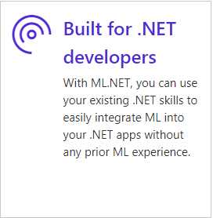
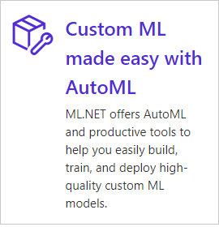

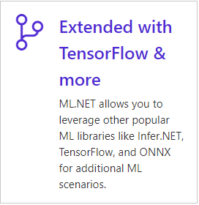
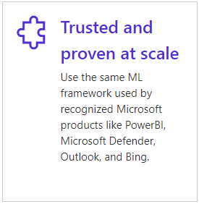
ML.NET
ANNOUNCED @ Build2019
ML.NET 1.0 @Build 2019
,

Slide 4
ML.Net Step By Step

Slide 5
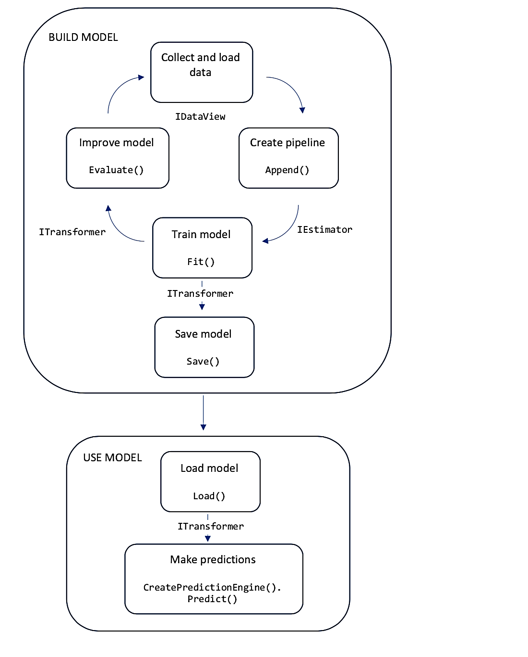

Slide 6
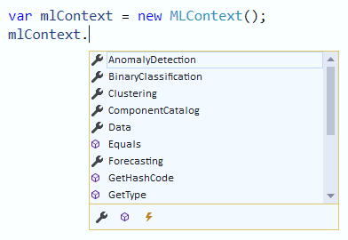
Create ML Context
MLContext is the starting point for all ML.NET operations. The MLContext is used for all aspects of creating and consuming an ML.NET model. It is similar conceptually to DbContext in Entity Framework
Once you have an instance of an MLContext , you can load and transform data, choose the best algorithm for your machine learning task, train your model. Once trained, you can test your model for accuracy, save it to disk, and use it to make predictions. An MLContext can be initialized from an model that was previously saved to disk.

Slide 7
Load Data
Machine learning uses known data (e.g. training data) to find patterns in order to make predictions on new, unknown data.
The inputs for machine learning are called Features, which are the attributes used to make predictions. The output of machine learning is called the Label, which is the actual prediction.
Data in ML.NET is represented as an IDataView, which is a flexible, efficient way of describing tabular data (e.g. rows and columns). IDataView objects can contain numbers, text, booleans, vectors, and more. You can load data from files or from real-time streaming sources to an IDataView.
LoadFromTextFile allows you to load data from TXT, CSV, TSV, and other file formats.
LoadFromEnumerable enables loading from in-memory collections, JSON/XML, relational and non-relational databases (e.g. SQL, CosmosDB, MongoDB), and many other data sources.
IDataView trainingData = mlContext.Data .LoadFromTextFile<SentimentInput>(dataPath, separatorChar: ',', hasHeader: true)
IDataView trainingData = mlContext.Data . LoadFromEnumerable<SentimentInput>(inMemoryCollection);

Slide 8
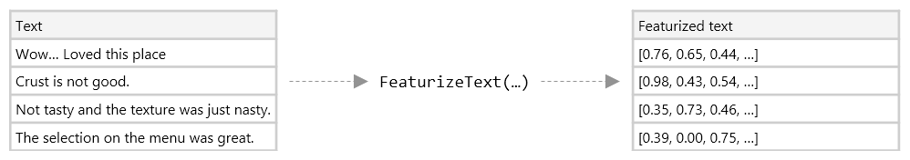
Transform Data
In most cases, the data that you have available isn't suitable to be used directly to train a machine learning model. The raw data needs to be pre-processed using data transformations.
Transformers take data, do some work on it, and return new, transformed data.
There are built-in set of data transforms for replacing missing values, data conversion, featurizing text, and more.
// Convert sentiment text into numeric features
IEstimator<ITransformer> dataTransformPipelinemlContext.Transforms.Text .FeaturizeText("Features", "SentimentText");

Slide 9
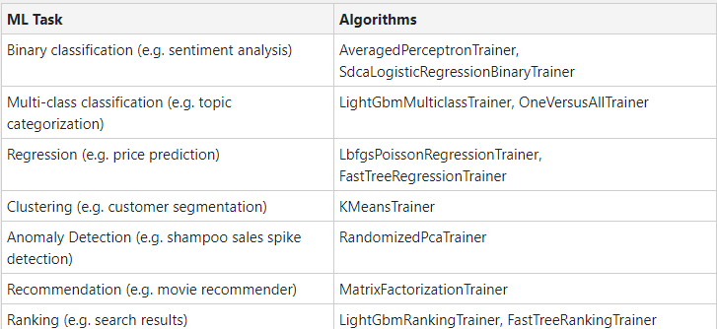
Choose Algorithm
When using machine learning and ML.NET, you must choose a machine learning task that goes along with your scenario. ML.NET offers over 30 algorithms (or trainers) for a variety of ML tasks:
IEstimator<ITransformer> trainer = mlContext.BinaryClassification.Trainers .AveragedPerceptron(labelColumnName: "Sentiment", featureColumnName: "Features")); IEstimator<ITransformer> trainingPipeline = dataTransformPipeline.Append(trainer);

Slide 10
Train Model
The data transformations and algorithms you have specified are not executed until you call the Fit() method (because of ML.NET's lazy loading approach). This is when model training happens.
An estimator takes in data, learns from the data, and creates a transformer. In the case of model training, the training data is the input, and the trained model is the output; the trained model is thus a transformer that turns the input Features from new data into output predictions.
ITransformer model = pipeline.Fit(trainingData);

Slide 11
Evaluate Model
// Make predictions on test data
IDataView predictions = model.Transform(testDataView);
// Evaluate model and return metrics
var metrics = mlContext.BinaryClassification .Evaluate(predictions, labelColumnName: "Sentiment");
// Print out accuracy metric
Console.WriteLine("Accuracy" + metrics.Accuracy);

Slide 12
Deploy and Consume Model
You can save your trained model as a binary file that is then integrated into your .NET applications.
Once you have saved the trained model, you can load the model in your other .NET applications.
You can then used the loaded model to start making predictions. You can use the Prediction Engine, which is a convenience API used for making single predictions, or the Transform method, which is used for making batch predictions.
mlContext.Model.Save(model, trainingData, "model.zip");
MLContext mlContext = new MLContext();
DataViewSchema predictionPipelineSchema;
ITransformer trainedModel = mlContext.Model.Load("model.zip", out predictionPipelineSchema);
var predEngine = mlContext.Model.CreatePredictionEngine(model);
SentimentInput sampleComment = new SentimentInput{ SentimentText = "This is very rude!" };
SentimentOutput result = predEngine.Predict(sampleComment);
Console.WriteLine(result.Prediction);

Slide 13
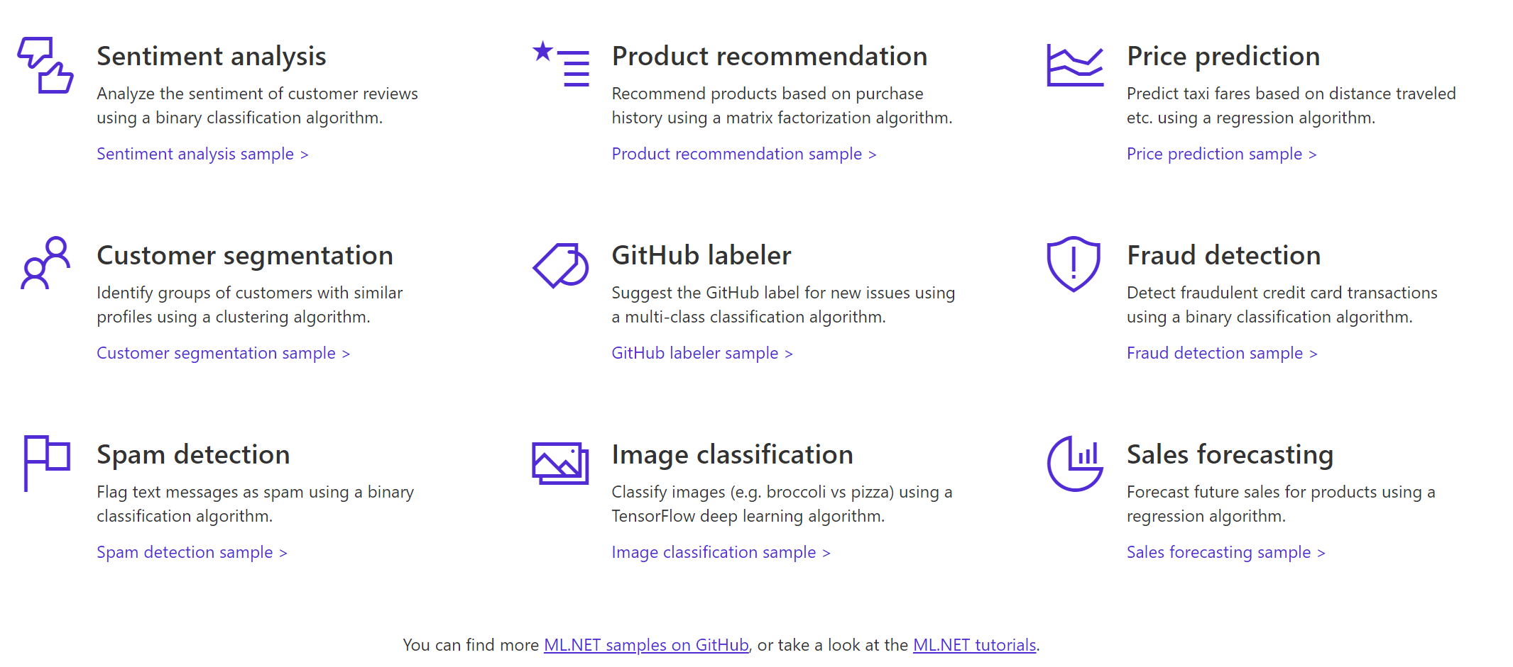

A few things you can do with ML.NET

Slide 14
The ways to integrate ml.net in your project
Model Builder
Command Line for Cross-Platform
ML.Net Nuget api

Slide 15
Model builder
Aka.ms/modelbuilder
Model Builder is a simple UI tool for developers to build, train and ship custom machine learning models in their applications easily with Auto ML
Developers with no ML expertise can use this simple visual interface to connect to their data stored in files or SQL Server, train the model and generate code for model training and consumption.

Slide 16
DEMO

Slide 17
What is the ML.NET Command-line Interface (CLI)?
You can run the ML.NET CLI on any command-prompt (Windows, Mac, or Linux) for generating good quality ML.NET models and source code based on your training dataset.
As shown in the figure below, it is simple to generate a high quality ML.NET model (serialized model .zip file) plus the sample C# code to run/score that model. In addition, the C# code to create/train that model is also generated, so that you can research and iterate on the algorithm and settings used for that generated "best model".

Slide 18
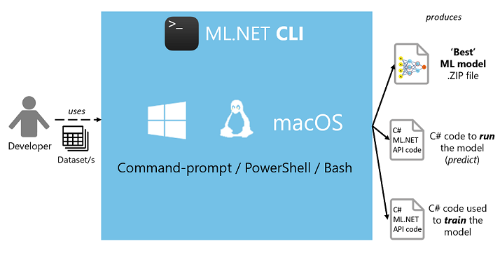

Slide 19
Output assets generated
A serialized model .zip ("best model") ready to use for running predictions.
C# solution with:
C# code to run/score that generated model (to make predictions in your end-user apps with that model).
C# code with the training code used to generate that model (for learning purposes or model retraining).
Log file with information of all iterations/sweeps across the multiple algorithms evaluated, including their detailed configuration/pipeline.

Slide 20
DEMO

Slide 21
ML.Net Nuget
https://www.nuget.org/packages/Microsoft.ML
ML.NET is a cross-platform open-source machine learning framework which makes machine learning accessible to .NET developers while offering a production high quality.
ML.NET allows .NET developers to develop/train their own models and infuse custom machine learning into their applications, using .NET, even without prior expertise in developing or tuning machine learning models while having a powerful end-to-end ML platform covering data loading from dataset files and databases, data transformations and many ML algorithms.

Slide 22
DEMO

Slide 23
References
https://github.com/dotnet/machinelearning
https://github.com/dotnet/machinelearning-samples
https://docs.microsoft.com/en-us/dotnet/machine-learning/

Slide 24
Any Questions?

Slide 25






Slide 26

Vinoth

